Slide 1

Global Marketing
Tenth Edition
Chapter 3
The Global Trade Environment
Copyright © 2020, 2017, 2015 Pearson Education, Inc. All Rights Reserved
Notes:
If this PowerPoint presentation contains mathematical equations, you may need to check that your computer has the following installed:
1) MathType Plugin
2) Math Player (free versions available)
3) NVDA Reader (free versions available)

Slide 2
Learning Objectives (1 of 2)
3.1 Explain the role of the W T O in facilitating global trade relations among nations.
3.2 Compare and contrast the four main categories of preferential trade agreements.
3.3 Explain the trade relationship dynamics among signatories of N A F T A.
3.4 Identify the four main preferential trade agreements in Latin America and the key members of each.
3.5 Identify the main preferential trade agreements in the Asia-Pacific region.

Slide 3
Learning Objectives (2 of 2)
3.6 Describe the various forms of economic integration in Europe.
3.7 Describe the activities of the key regional organizations in the Middle East.
3.8 Identify the issues for global marketers wishing to expand in Africa.

Slide 4
G A T T
General Agreement on Tariffs and Trade
Treaty among nations to promote trade among members established in 1947
Handled trade disputes
Lacked enforcement power; nicknamed the “General Agreement to Talk and Talk”
Disputes lasted for years
Replaced by World Trade Organization in 1995

Slide 5
The World Trade Organization
Forum for trade-related negotiations among 160 members
Based in Geneva
Serves as dispute mediator through D S B
60-day negotiation period; advances to a 3-member panel for resolution within 9 months; may advance to the Appellate Body
Has enforcement power and can impose sanctions
Formed on 1-1-1995
Notes:
The website for the WTO is www.wto.org
Location: Geneva, Switzerland Established: 1 January 1995 Created by: Uruguay Round negotiations (1986-94) Membership: 160 countries Budget: 197 million Swiss francs for 2015 Secretariat staff: 640 Head: Roberto Azevedo (Director-General)
Functions: • Administering WTO trade agreements • Forum for trade negotiations • Handling trade disputes • Monitoring national trade policies • Technical assistance and training for developing countries • Cooperation with other international organizations
The Dispute Settlement Body of neutral staff members mediates unfair trade barriers and other issues. For 60 days, parties are expected to negotiate in good faith. After that, the DSB will appoint a three-member panel of trade experts to hear the case behind closed doors. The panel must rule in nine months. The losing party has the right to turn to a seven-member appellate body. If, after due process, a country’s policies are found to violate WTO rules, it is expected to change those policies. If it does not, trade sanctions may be imposed.
Trade ministers meet annually to work on improving world trade. The Doha Round began in 2001.

Slide 6
Preferential Trade Agreements
Many countries seek to lower barriers to trade within their regions
P T A s give partners special treatment and may discriminate against others
Over 300 P T A s have been notified to the W T O
Meet every 2 years but haven’t been successful
Notes:
It is customary to notify the WTO when countries enter into PTAs. Strictly speaking, few fully conform to WTO requirements; none, however, have been disallowed.

Slide 7
Hierarchy of P F Ts

Slide 8
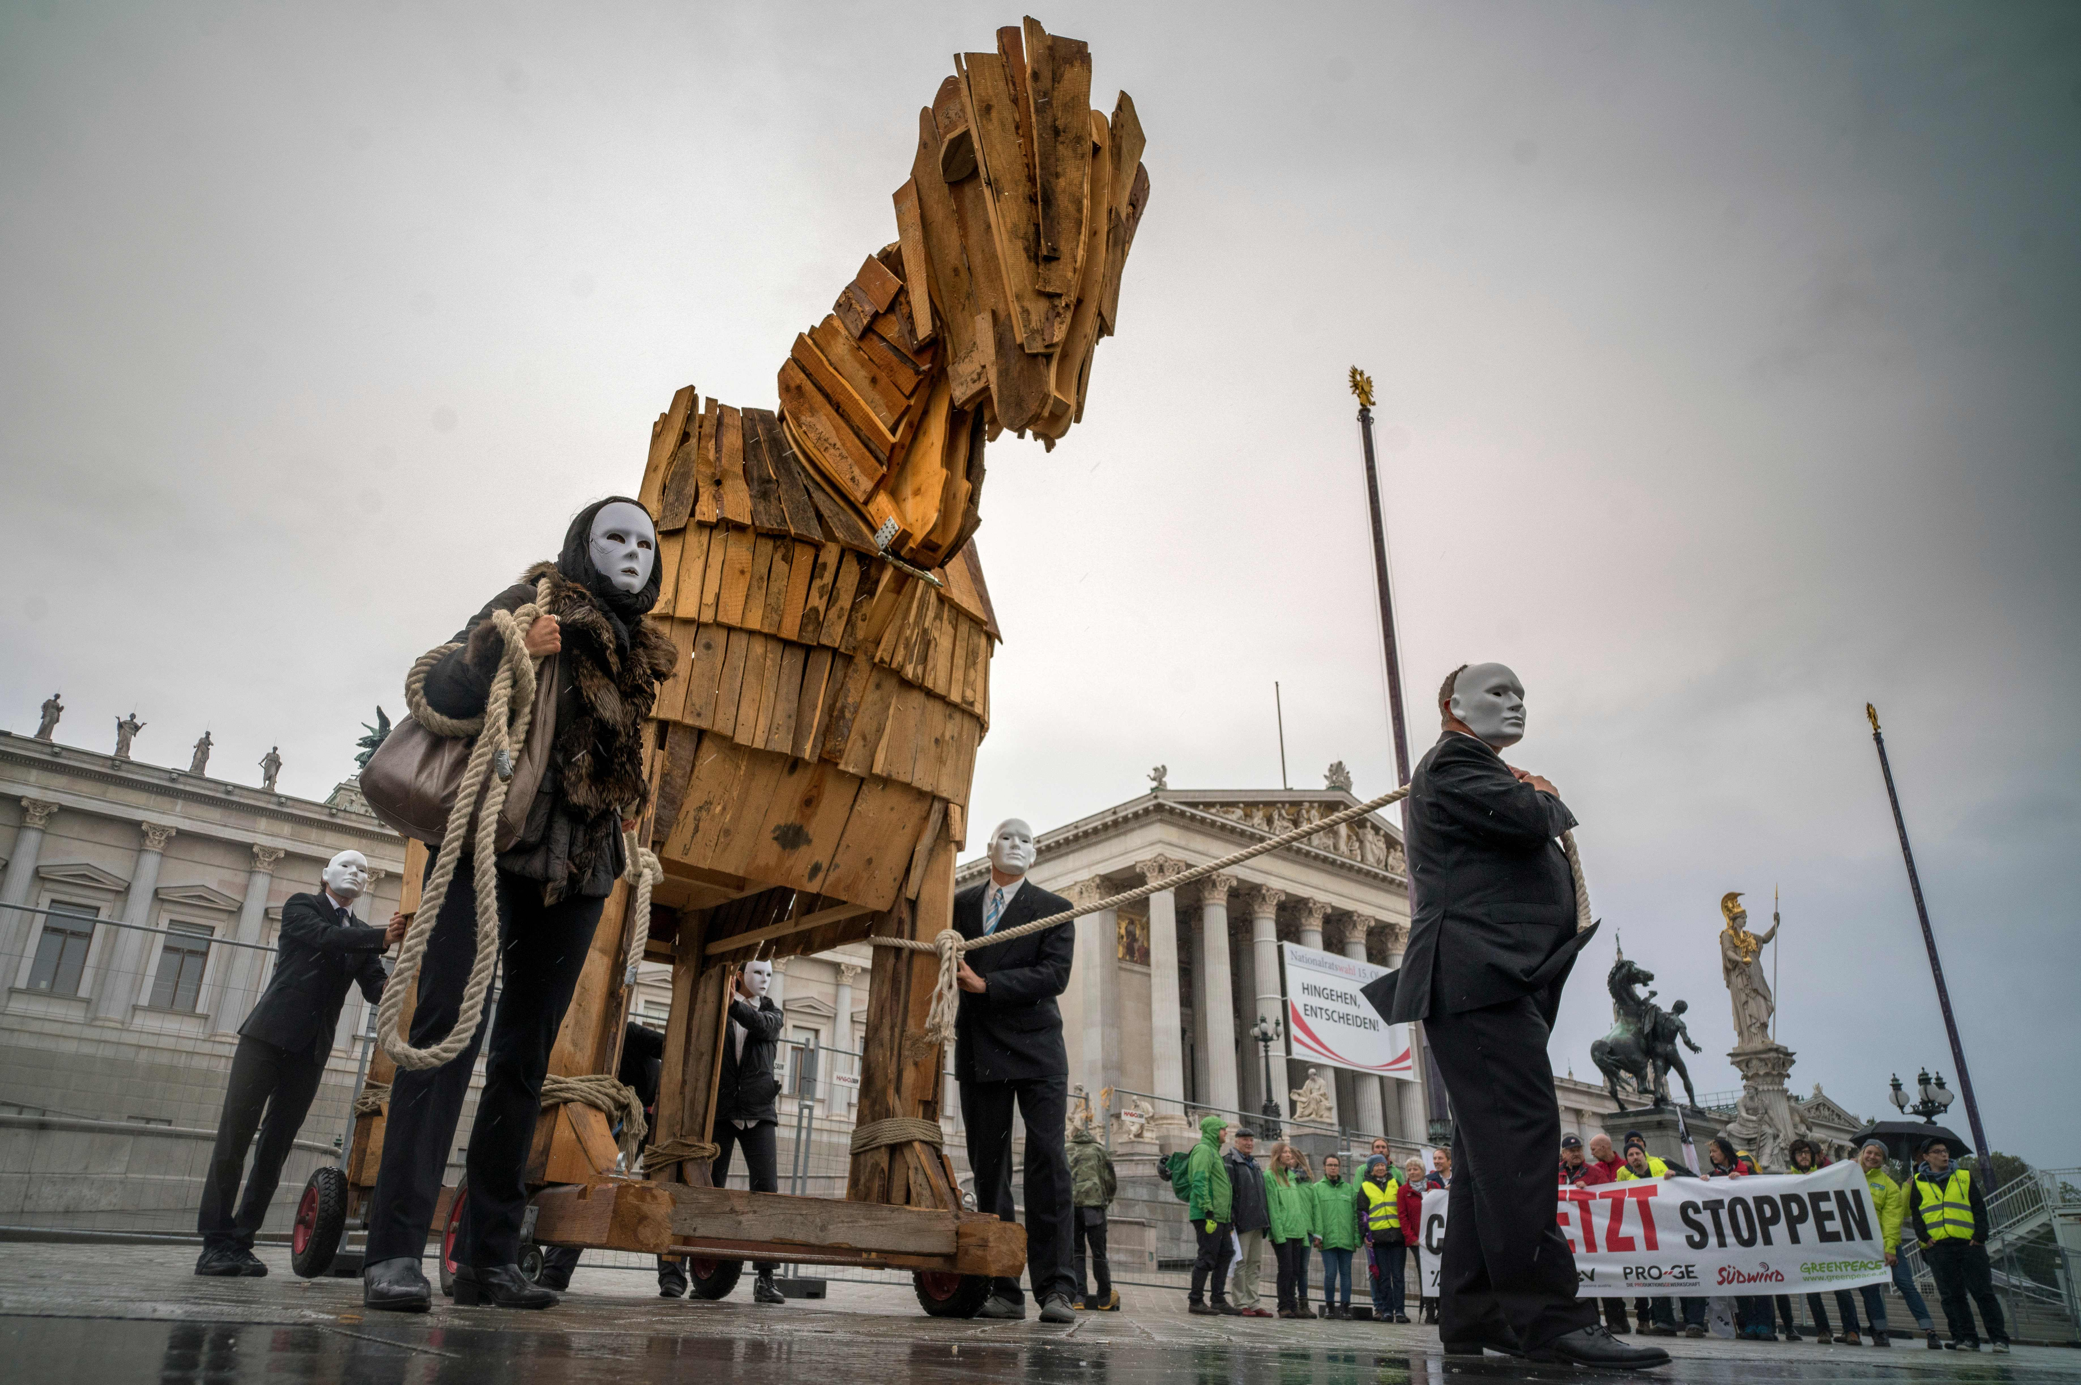
Free Trade Area
Two or more countries agree to abolish tariffs and other barriers to trade amongst themselves
Countries continue independent trade policies with countries outside agreement
Rules of origin requirements restrict transshipment of goods from the country with the lowest tariff to another
Protesters opposed a trade agreement in Vienna, 2016
Notes:
Sometimes duties may be eliminated on the day of the agreement or phased out over time.
Chile and Canada established an FTA in 1997. A Caterpillar tractor made in Canada could be shipped to Chile duty free. A U.S.-made tractor could not be shipped through Canada to Chile because the “Made in the USA” label would subject it to about $13,000 in duties. Little wonder that the U.S. negotiated its own agreement with Chile that came into effect in 2003.
Other FTAs:
European Economic Union—the EU plus Norway, Liechtenstein, and Iceland
The Group of Three (G3)—Colombia, Mexico, and Venezuela
The Closer Economic Partnership Agreement—China and Hong Kong
U.S. and South Korea, Panama and Colombia long delayed FTAs were ratified by the U.S. Congress in Oct. 2011

Slide 9
Customs Union
Evolution of Free Trade Area
Includes the elimination of internal barriers to trade (as in F T A)
And establishes common external barriers (C E Ts) to trade
Examples: The E U and Turkey, the Andean Community, Mercosur, Caricom, Central American Integration System (S I C A)
Notes:
The EU’s and Turkey’s 1996 customs union boosted two-way trade above the average annual level of $20 billion and eliminated tariffs averaging 14% that added $1.5 billion/year to the cost of European goods imported into Turkey.

Slide 10
Common Market
Includes the elimination of internal barriers to trade (as in free trade area)
And establishes common external barriers to trade (as in customs union)
And allows for the free movement of factors of production, such as labor, capital, and information
Notes:
Current Central and South American customs unions SICA, Caricom, and the Andean Community may evolve into common markets.

Slide 11
Economic Union (1 of 2)
Includes the elimination of internal barriers to trade (as in free trade area)
And establishes common external barriers to trade (as in customs union)
And allows for the free movement of factors of production, such as labor, capital, and information (as in common market)
And coordinates and harmonizes economic and social policy within the union
Notes:
In the European Union, countries must harmonize their licensing standards so that professionals such as doctors or lawyers qualified in one country may work in another. Harmonization is an important concept to be stressed.

Slide 12
Economic Union (2 of 2)
Full evolution of economic union
creation of unified central bank
use of single currency
common policies on issues such as agriculture, social policy, transport, competition, mergers, taxation
requires extensive political unity
would lead to a central government in time
Notes:
The full evolution of an economic union would involve the creation of a unified central bank; the use of a single currency; and common policies on agriculture, social services, welfare, regional development, transport, taxation, competition, and mergers. A true economic union requires extensive political unity, which makes it similar to a nation. The further integration of nations that were members of fully developed economic unions would be the formation of a central government that would bring together independent political states into a single political framework. The EU is approaching its target of completing most of the steps required to become a full economic union, with one notable setback: Despite the fact that 16 member nations ratified a proposed European Constitution, the initiative was derailed after voters in France and the Netherlands voted against the measure.

Slide 13
U.S. Goods Exports and Exports in 2016
Figure 3-2 United States’ Top Import/Export Partners

Slide 14
Latin America: S I C A, Andean Community, Mercosur, Caricom
Includes the Caribbean, Central, and South America
History of no growth, inflation, debt, and protectionism has given way to free markets, open economies, and deregulation
Some concern for further growth with the rise of left-leaning politicians
Notes:
The allure of the Latin American market has been its considerable size and huge resource base. After a decade of no growth, crippling inflation, increasing foreign debt, protectionism, and bloated government payrolls, the countries of Latin America have begun the process of economic transformation. Balanced budgets are a priority and privatization is underway. Free markets, open economies, and deregulation have begun to replace the policies of the past. With the exception of Cuba, democratically elected governments are found throughout Latin America. Policy makers have recognized the benefits of free-market forces and the advantages of participating fully in the global economy. In many countries, tariffs that sometimes reached as much as 100 percent or more have been lowered to 10 to 20 percent.
Global corporations are encouraged by import liberalization, the prospects for lower tariffs within subregional trading groups, and the potential for establishing more efficient regional production. Many observers envision an FTA throughout the region.

Slide 15
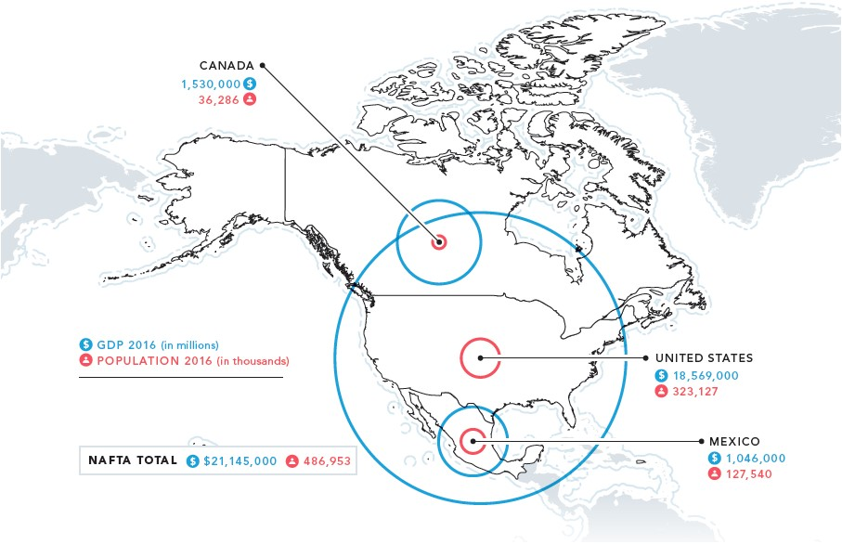
North America
Figure 3-3 N A F T A Income and Population

Slide 16
Central American Integration System (S I C A)
El Salvador, Honduras, Guatemala, Nicaragua, Costa Rica, and Panama
Moving towards a common market
Common External Tariff of 0 to 15%
Retains tariffs on goods also produced in importing country

Slide 17
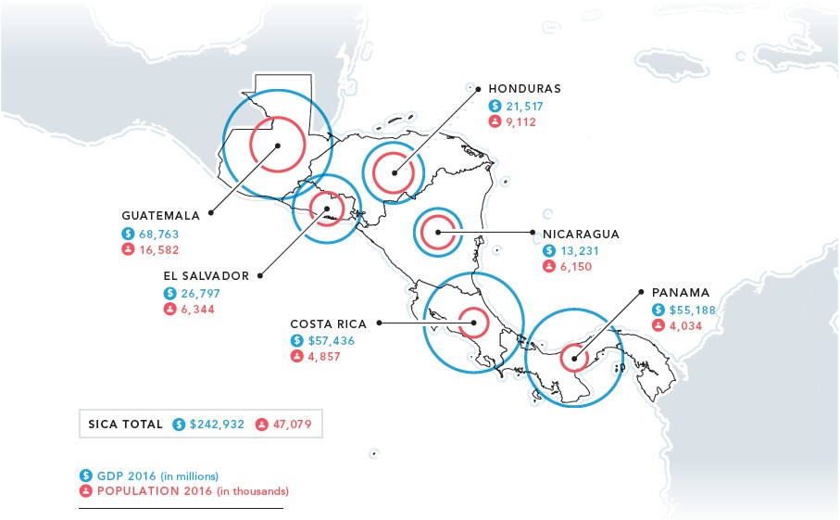
Central American Integration System
Figure 3-4 S I C A Income and Population

Slide 18
D R-C A F T A
S I C A members El Salvador, Honduras, Guatemala, Nicaragua, Costa Rica joined the Dominican Republic and the United States in a F T A
80% of U S goods and 50% + of agricultural goods are duty free
Paperwork is reduced
Reduced risks mean more direct foreign investment
Notes:
In 2006 and 2007, implementation of the Central American Free Trade Agreement with the United States created a free trade area known as DR-CAFTA that includes five SICA members (El Salvador, Honduras, Guatemala, Nicaragua, and Costa Rica; Panama is excluded) plus the Dominican Republic. Implementation has been slow, but some changes have already taken effect. For example, 80 percent of U.S. goods and more than half of U.S. agricultural products can now be imported into Central America on a duty-free basis. Benefits to Central American companies include a streamlining of export paperwork and the adoption of an online application process. The region will attract more foreign investment as investors see reduced risk thanks to clearer rules. In Costa Rica alone, foreign direct investment increased by 15 percent from 2012 to 2013.
In addition, myriad Central American companies operated in the “shadow economy,” with many commercial transactions going unreported. In the mid-2000s, for example, undocumented economic activity in Guatemala and El Salvador amounted to roughly 50 percent of GDP. Government tax revenues should increase as companies join the formal economy to take advantage of CAFTA’s benefits. Critics of the agreement note that signatory countries are not obliged to comply with international labor standards such as those established by the International Labor Organization (ILO). The negative repercussions, these critics say, include low wages and poor working conditions.
Despite progress, attempts to achieve integration in Central America have been described as uncoordinated, inefficient, and costly. Tariffs still exist on imports of products—sugar, coffee, and alcoholic beverages, for example—that are also produced in the importing country. As one Guatemalan analyst remarked more than a decade ago, “Only when I see Salvadoran beer on sale in Guatemala and Guatemalan beer on sale in El Salvador will I believe that trade liberalization and integration is a reality.”

Slide 19
Andean Community
Bolivia, Colombia, Ecuador, Peru
50th anniversary in 2019
Customs Union
Abolished foreign exchange, financial and fiscal incentives, and export subsidies, lower tariffs
Established common external tariffs
Notes:
Blessed with a location near the equator, Ecuador’s cut-flower industry generates hundreds of millions of dollars in sales each year. For years, thanks to the Andean Trade Promotion and Drug Eradication Act, flowers from Ecuador, Colombia, Bolivia, and Peru were imported into the United States duty-free. The U.S. Congress passed the act to encourage Latin American farmers to cultivate ornamental flowers rather than plants that are part of the illegal drug trade. However, the act expired at the end of 2013; for Peru and Colombia, the flower trade is covered by bilateral trade agreements. Although Ecuador’s duty-free status was extended, President Rafael Correa is opposed to free trade talks with the United States.
Peru is benefiting from surging demand and high prices for maca, a native vegetable root crop that grows at high altitudes and whose origins can be traced back to pre-Incan times Thanks to a centuries-old reputation based on its medicinal qualities—as an aphrodisiac and, more recently, as a cancer-fighting agent—maca has become a hot commodity in China and Japan. In the United States, organic maca is marketed at Whole Foods stores as an “Incan superfood.” Anxious to retain control of this valuable agricultural export, officials at Peru’s National Commission Against Biopiracy have ramped up efforts to prevent maca seeds from being smuggled out of the country for cultivation elsewhere.

Slide 20
Common Market of the South (Mercosur)
Argentina, Brazil, Paraguay, Uruguay, Venezuela
Begun in 1995
Customs union, seeks to become common market
Internal tariffs eliminated
Established common external tariffs up to 20%
In time, factors of production will move freely through member countries
E U is the #1 trading partner
Bolivia, Chile, Ecuador, Peru
Associate members
Participate in free trade area but not customs union
Notes:
March 2016 marked the 25th anniversary of signing of the Asunción Treaty. The four members began phasing in tariff reform in 1995. Internal tariffs were eliminated, and CETs of 20 percent or less were established. In theory, goods, services, and factors of production will ultimately move freely throughout the member countries; until this goal is achieved, however, Mercosur will actually operate as a customs union rather than as a true common market. Today, about 90 percent of goods are traded freely; however, individual members of Mercosur can change both internal and external tariffs when it suits the respective government. Much depends on the successful outcome of this experiment in regional cooperation. The early signs were positive, as trade between the four full member nations grew dramatically during the 1990s. However, the region has experienced a series of financial crises; for example, Brazil’s currency was devalued in 1995 and again in 1999.

Slide 21
Figure 3-5 Mercosur and Andean Community Income and Population

Slide 22
Caricom
Founded in 1973 by 15 members
17 million population
Stagnant for 20 years
Customs Union in 1991 with common external tariffs
Rejected the idea of an economic union in 1998 as a single currency would not be especially beneficial
Caribbean Basin Trade Partnership Act exempts textile and apparel exports to the U.S. market access from duties and tariffs. Caribbean Basin Initiative of 20 nations includes Caricom.
Notes:
Caricom was formed in 1973 as a movement toward unity in the Caribbean. It replaced the Caribbean Free Trade Association (CARIFTA) founded in 1965. The members are Antigua and Barbuda, Bahamas, Barbados, Belize, Dominica, Grenada, Guyana, Haiti, Jamaica, Montserrat, St. Kitts and Nevis, St. Lucia, St. Vincent and the Grenadines, Suriname, and Trinidad and Tobago. The population of the entire 15-member Caricom is about 17 million.
In the past few years, a trade dispute between the United States and Antigua and Barbuda has raised some eyebrows. Until recently, Antigua’s online gambling industry generated more than $3 billion annually. However, after Washington clamped down on Internet poker sites, Antigua’s revenues slumped. Believing that the United States was violating international law, Antigua appealed to the WTO. The trade body ruled in favor of Antigua, and gave it the right to sell various types of U.S. intellectual property, including software and DVDs, without compensating the trademark and copyright owners.

Slide 23
Asia-Pacific: The Association of Southeast Asian Nations (A S E A N)
Brunei, Cambodia, Indonesia, Laos, Malaysia, Myanmar, Philippines, Singapore, Thailand, Vietnam
“A S E A N plus six” (Japan, China, Korea, Australia, New Zealand, India) working towards an economic community
China/A S E A N F T A established in 2010 removes 90% of tariffs on traded goods

Slide 24
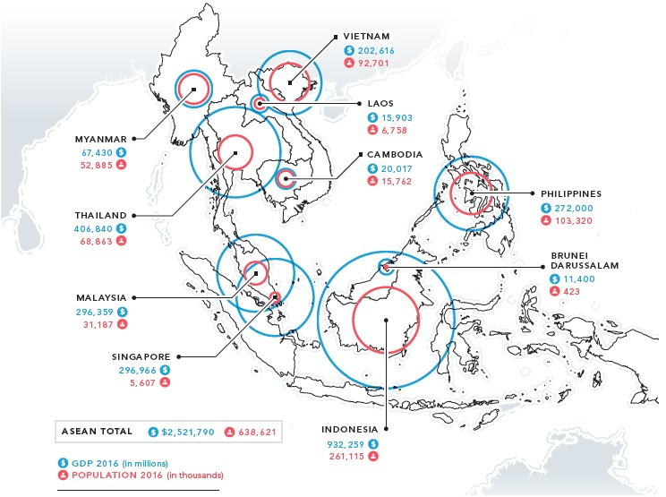
A S E A N
Figure 3-7 A S E A N Income and Population

Slide 25
Singapore
World’s 2nd largest container port
2nd highest standard of living in the region behind Japan
5.4 million people
95% literacy rate
Over 3,000 companies
Crime is nearly nonexistent
Notes:
Singapore represents a special case among the ASEAN nations. Singapore went from a British colony to a 240 sq. mile industrial power in less than 30 years.
It accounts for more than 1/3 of U.S. trading with ASEAN. 2010: $39 billion in U.S. exports; $27.1 billion in U.S. imports; 32% of imports are redirected to neighbors.
In fewer than three decades, Singapore transformed itself from a British colony to a vibrant, 240-square-mile industrial power. Singapore has an extremely efficient infrastructure—the Port of Singapore is the world’s second-largest container port (Hong Kong’s ranks first)—and a standard of living second in the region only to Japan’s. Singapore’s 5.4 million citizens have played a critical role in the country’s economic achievements by readily accepting the notion that “the country with the most knowledge will win” in global competition. Excellent training programs and a 95 percent literacy rate help explain why Singapore has more engineers per capita than the United States. Singapore’s Economic Development Board has also actively recruited business interest in the nation. The manufacturing companies that have been attracted to Singapore read like a who’s who of global marketing and include Hewlett-Packard, IBM, Philips, and Apple; in all, more than 3,000 companies have operations or investments in Singapore.

Slide 26
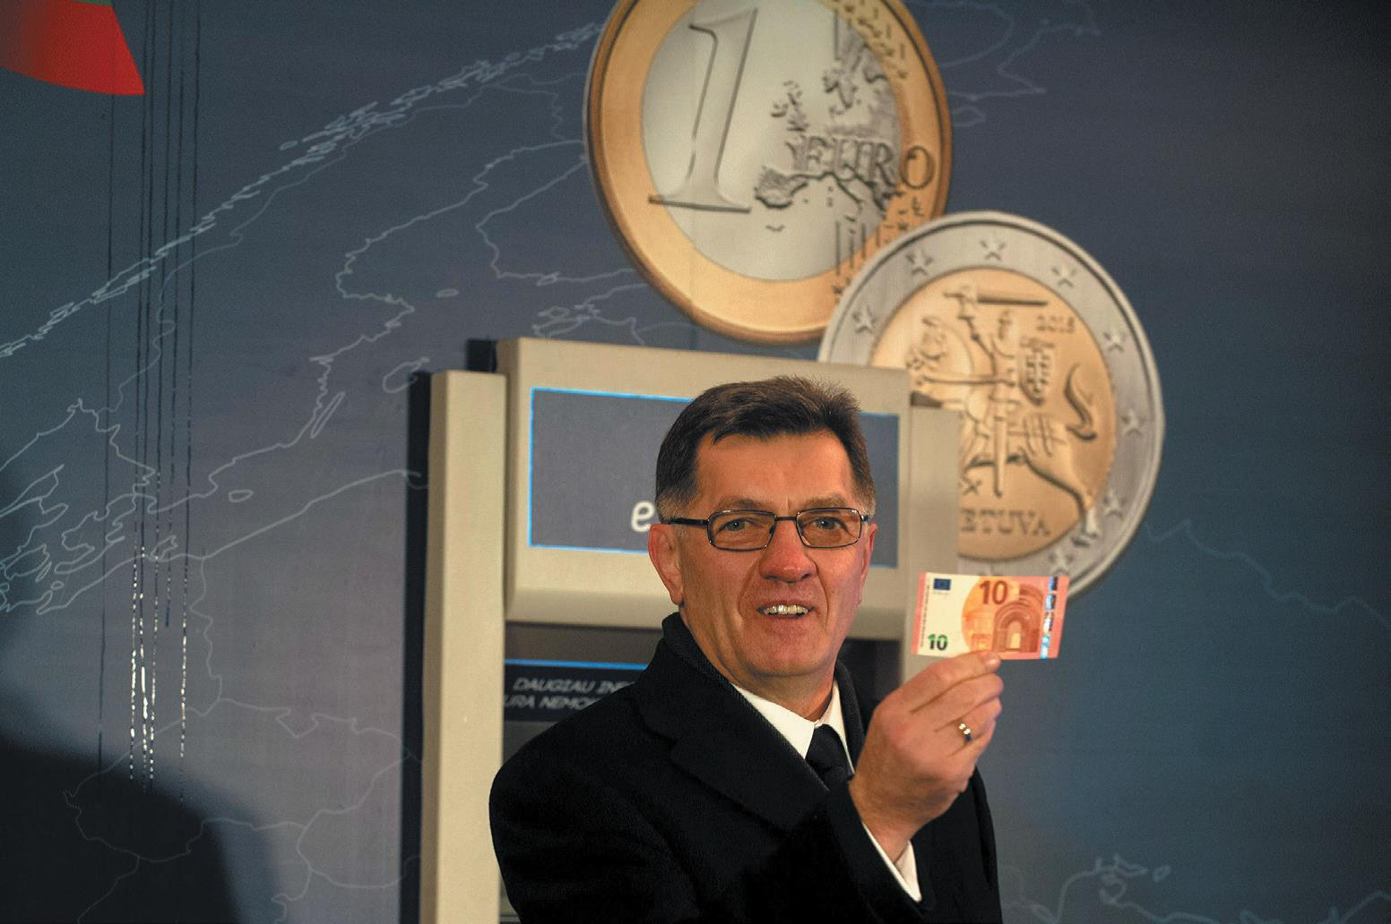
The European Union (E U) (1 of 3)
Initially began with the 1958 Treaty of Rome
Objective is to harmonize national laws and regulations so that goods, services, people, and money could flow freely across national boundaries
1991 Maastricht Treaty set stage for transition to an economic union with a central bank and single currency (the Euro in 2002)
Lithuania joined the euro zone on January 1, 2015.
Notes:
The origins of the European Union (EU) can be traced back to the 1958 Treaty of Rome. The six original members of the European Community (EC), as the group was called then, were Belgium, France, Holland, Italy, Luxembourg, and West Germany. In 1973, Great Britain, Denmark, and Ireland were admitted, followed by Greece in 1981 and Spain and Portugal in 1986. Beginning in 1987, the 12 countries that were EC members set about the difficult task of creating a genuine single market in goods, services, and capital. In other words, the goal was to create a true economic union. Adopting the Single European Act by the end of 1992 was a major EC achievement; the Council of Ministers adopted more than 200 pieces of legislation and regulations to make the single market a reality.
For the past 15 years, EU enlargement was an important story in the region. Cyprus, the Czech Republic, Estonia, Hungary, Poland, Latvia, Lithuania, Malta, the Slovak Republic, and Slovenia became full EU members on May 1, 2004. Bulgaria and Romania joined in 2007; Croatia, the newest member, joined on July 1, 2013. As shown in Figure 3-8, the 28 nations of the EU are home to 450 million people and constitute the world’s largest economy, with more than $15 trillion in combined GDP. As discussed in the chapter opening case, the EU28 will become the EU27 when Brexit is triggered in 2019 and Great Britain leaves the EU.

Slide 27
The European Union (E U) (2 of 3)
28 countries will become 27 after Brexit
450 million people
$15 trillion G N I
Euro currency, 1999
Harmonization of laws and regulations
Price transparency
No customs at national borders

Slide 28
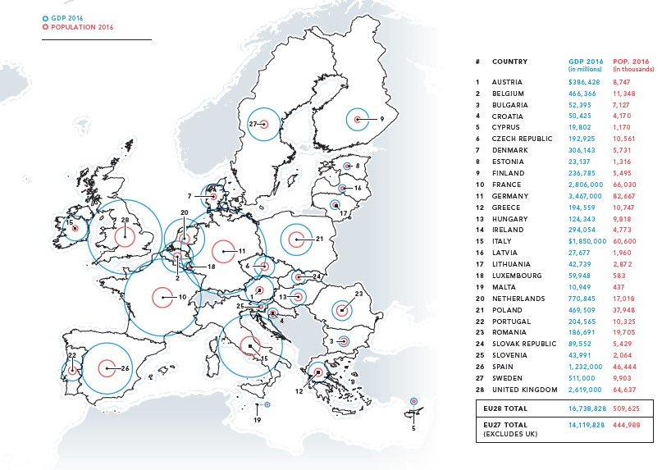
The European Union (E U) (3 of 3)
Figure 3-8 The 28-Nation E U: Income and Population (Pre-Brexit)

Slide 29
The Middle East
Afghanistan, Bahrain, Cyprus, Egypt, Iran, Iraq, Israel, Jordan, Kuwait, Lebanon, Oman, Qatar, Saudi Arabia, Syria, the United Arab Emirates, Yemen
Primarily Arab, many Persians and some Jewish
95% Muslim, 5% Christian and Jewish
Wide variation in Economic Freedom rankings
Bahrain is 18th, U A E is 25th, Saudi Arabia is 77nd
Oil prices drive commerce
25% of world’s oil in Saudi Arabia
Arab Spring 2011
Gulf Cooperation Council key regional organization
Notes:
Countries fall into all categories of economic freedom as discussed in Chapter 2.
The price of oil drives business. Bahrain, Iraq, Iran, Kuwait, Oman, Qatar, and Saudi Arabia hold significant world oil reserves. Saudi Arabia, with 22 million people and 25% of the world’s oil, is the most important market in the region.
Connection is a key word in conducting business in the Middle East. Forming relationships, establishing trust, and respect are key. Arab businesspeople do business in person, not over the phone or through correspondence. Women are not usually part of a business or social scene for traditional Arabs.
In 2011 the region was rocked by demonstrations and protests that have been described as “the Arab awakening” and “the Arab spring.” The governments of Tunisia and Egypt were overthrown, civil war broke out in Libya, and Syria’s regime cracked down on insurgent activists. Elsewhere in the region, leaders were forced to make economic and political concessions. Prior to the uprisings, Syria had been a case study in the slow pace of change coming to the Middle East. Citing China’s success at opening its economy while maintaining social control, President Bashar al-Assad took steps to move Syria away from a rigid socialist economic model. Private banks opened for business, a stock market was established, and possessing foreign currency became legal for Syrian citizens. Ties with the West began improving, too; U.S. President Barack Obama lifted some sanctions and named an ambassador to Syria. Entrepreneurs with ties to Syria began returning from Lebanon and the United States, a trend that helped spark a consumer culture. In Damascus, signs of economic rebirth included a Ford dealership, a KFC restaurant, and Benetton boutiques.

Slide 30
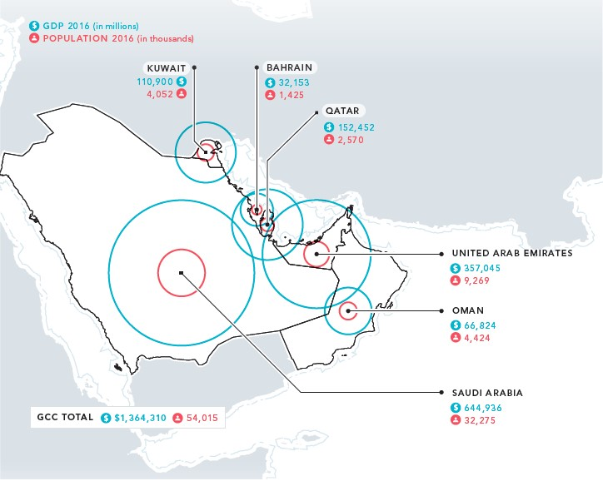
Gulf Cooperation Council
Established in 1981 by 6 countries with 45% of world’s oil, only 18% of output
These countries are attempting to diversify industries
Figure 3-9 G C C Income and Population

Slide 31
Africa
54 nations over three distinct areas
Republic of South Africa
North Africa
Black Africa or sub-Saharan Africa
Arabs in the north differ politically and economically from the rest of the continent
Mena: Middle East and North Africa
Viewed as a regional entity
Regional agreements
Economic Community of West African States
East African Cooperation
South African Development Community
Notes:
11.7 million sq. miles, or 3 ½ times the size of the U.S.
54 nations
1.3% of world’s wealth
11.5% of world’s population
Average per capita income ranges from $1,505 in sub-Saharan countries to $7,800 in the North Africa/Middle East region.
Arabs of northern Africa are politically and economically differentiated from the rest of the continent. Libya, Algeria, and Egypt benefit from oil resources.
By January 1990, tariffs on 25 items manufactured in ECOWAS member states had been eliminated. The organization installed a computer system to process customs and trade statistics and to calculate the loss of revenue resulting from the liberalization of intercommunity trade. In June 1990, ECOWAS adopted measures to create a single monetary zone in the region by 1994. Despite such achievements, economic development has occurred unevenly in the region. In recent years, Ghana has performed impressively, propelled by deals related to its oil, gas, and mineral sectors. China has signed deals with the region that are worth $15 billion. By contrast, Liberia and Sierra Leone are still experiencing political conflict and economic decline.
East African Community: Kenya, Uganda, Tanzania, Rwanda, and Burundi are the five nations that comprise the world’s newest common market. The formation of the common market in 2010 resulted in the free movement of people, goods and services, and capital within the community. Members also intend to move swiftly to establish an economic union. The first step will be creating a monetary union; although negotiations were still ongoing in mid-2013, the goal is to introduce a common currency in 2015. There is even talk about forming a single nation.
In 1992, the Southern African Development Community (SADC) superseded the South African Development Coordination Council as a mechanism by which the region’s black-ruled states could promote trade, cooperation, and economic integration. The members are Angola, Botswana, Democratic Republic of Congo (formerly Zaire), Lesotho, Malawi, Mauritius, Mozambique, Namibia, South Africa, Seychelles, Swaziland, Tanzania, Zambia, and Zimbabwe. South Africa joined the community in 1994; it represents about 75 percent of the income in the region and 86 percent of intraregional exports. The SADC’s ultimate goal is a fully developed customs union; in 2000, an 11-nation free trade area was finally established (Angola, the Democratic Republic of Congo, and Seychelles are not participants). South Africa and the EU signed a Trade, Development, and Cooperation Agreement (TDCA) in 2000; two-way trade and foreign direct investment have increased substantially since then. Meanwhile, other SADC members are concerned that such an arrangement provides European global companies with a base from which to dominate the continent. South Africa, Botswana, Lesotho, Namibia, and Swaziland also belong to the Southern African Customs Union (SACU).

Slide 32

Copyright
This work is protected by United States copyright laws and is provided solely for the use of instructors in teaching their courses and assessing student learning. Dissemination or sale of any part of this work (including on the World Wide Web) will destroy the integrity of the work and is not permitted. The work and materials from it should never be made available to students except by instructors using the accompanying text in their classes. All recipients of this work are expected to abide by these restrictions and to honor the intended pedagogical purposes and the needs of other instructors who rely on these materials.

